Slide 1

Spend Caps How To Guide
October 2018

Slide 2
Small Business

Slide 3
Spend Caps – Small Business
What are Spend Caps?
A spend cap is an option you can choose to limit how much you spend on top of your monthly plan from certain types of included charges.
Customers will be able to add, remove and change their chosen spend cap in-life via Customer Services.
When were they introduced?
Spend Caps were introduced on the 1st October 2018
Why do we have Spend Caps?
A new OFCOM regulation called the Digital Economy Act came into effect on the above date. The regulation states that communications providers for mobile services must not enter into a contract with a new or upgrading customer without giving them the option to set a monthly spend cap to cover
certain types of charges over and above their standard price plan cost.

Slide 4
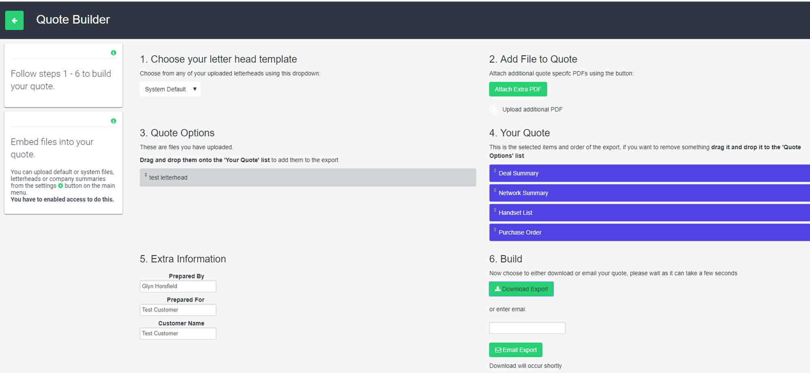
Quote Builder – Quick Quote
The JEM quote builder has been constructed to allow flexibility for partner quoting when using spend caps. If you wish to provide a quick proposal there is no requirement to complete the customer details within the order screen.
Once you get to this stage (left) if you click download export, your proposal will be generated without the spend caps on, to allow you to quote freely to your client as many times as needed, without having to discuss spend caps with them at this stage.
Example on the next page.

Slide 5
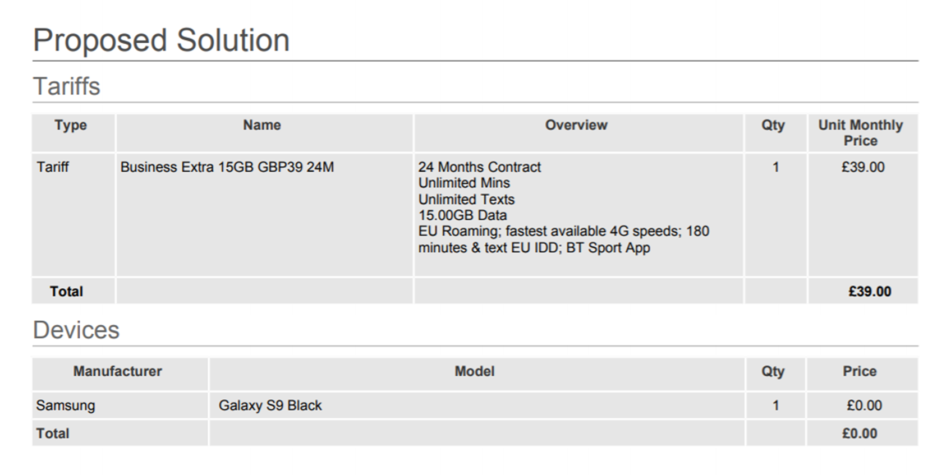
Quote Builder – Proposal Example
Example proposal with no spend caps listed, to allow you to quote your client as normal. At this point the proposal can be downloaded and saved to allow you to send from your own email address to the client.

Slide 6
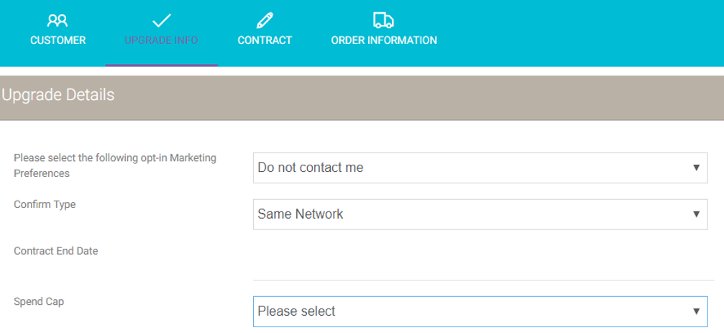
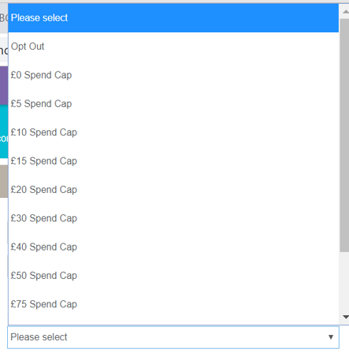
Quote Builder – Small Business upgrade info screen
You are able to select your spend cap amount in this screen. The cap that you select will be applied to all lines. Should you wish to personalise at connection stage and amend you are able to do so.
Once you have clicked the spend cap drop down you will be able to select the cap required from the list. You also have the option to opt-out should your client wish to do so. Once selected, click save and update to ensure your selection is correctly logged in JEM.

Slide 7
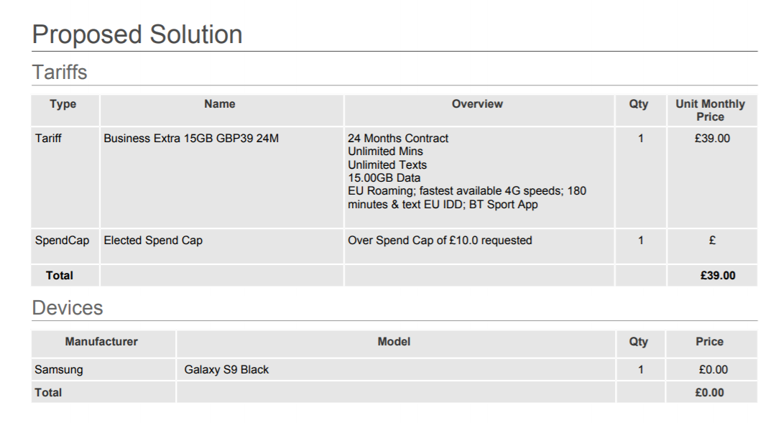
Quote Builder – Small Business proposal screen
After selecting your spend cap in the drop down, it will now auto populate into your proposal.
It is important to ensure at this stage that the selected spend cap is correct.

Slide 8
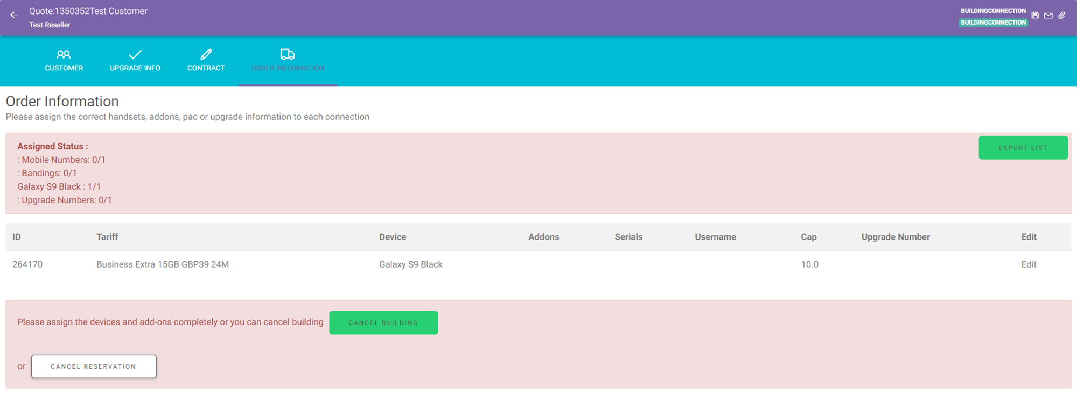
Quote Builder – Small Business order screen
Once you have saved and updated in the upgrade screen you can move on to the order screen. As you can see the spend cap has auto populated in the order screen for you. To complete the order screen you will need to select edit, you can also change the spend cap if required at this point of the process. (Please see next slide)

Slide 9
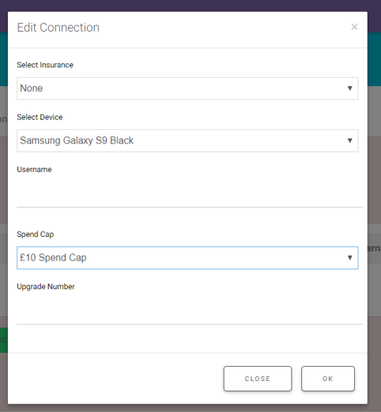
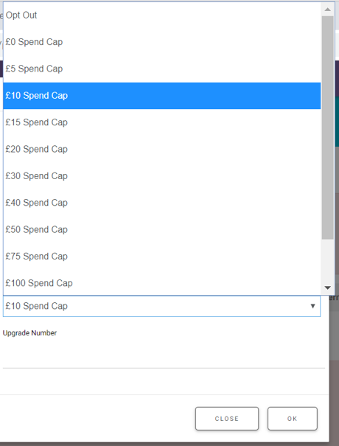
Quote Builder – Small Business connection screen
This is what you will see once you have clicked Edit. You have the spend caption option as before.
As you can see you get the same options as on the upgrade screen to change the spend cap amount or opt out if required. Each user can have their own individual spend cap value.

Slide 10
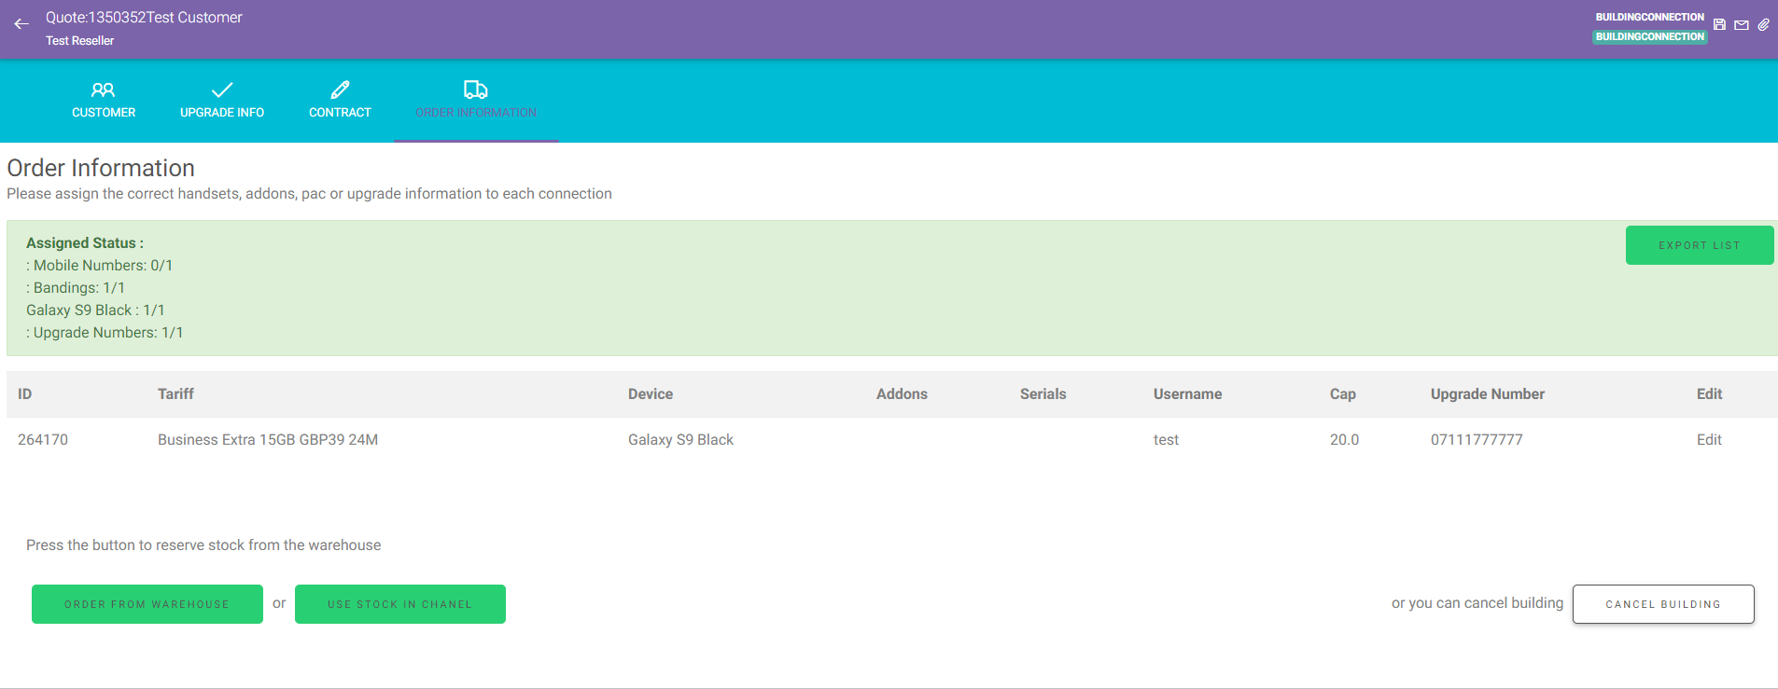
Quote Builder – Small Business order screen
Once you have changed your spend cap amount, JEM will update the order screen for you. Details including the spend cap are auto populated into the EE compliant connection template, which is then submitted to the network for connection. Once your order screen has gone green you can proceed to connection as normal.
Please note – before proceeding to connection if you have multiple spend cap amounts on multiple lines you MUST have noted them in the bespoke options tab first in the proposal. If the customer wishes to amend at any point please raise a JEM ticket.

Slide 11
Corporate

Slide 12
Spend Caps - Corporate
A Corporate customer can set an account level cap, the only exception to this would be a copy account, users on a copy account require an individual line cap
Only overage spend on voice, text and data counts towards the cap (inc. daily roaming charges)
If customer approaches the cap EE will notify them (via the email addresses provided at point of connection) and give them the chance to suspend or remove it
If the customer reaches their cap and does not provide consent to suspend or remove the cap, their service will be restricted preventing any further chargeable usage
You still have the same flexibility quoting your client as you would on small business using JEM. The key difference on Corporate is that the spend cap is highlighted on the Corporate DA/EEBA. The spend cap at point of connection MUST match the spend cap selected in the DA/EEBA that is generated. If the EEBA has been signed by the customer and prior to connection they decide to change their spend cap you will need to request a new EEBA and start the process again.

Slide 13
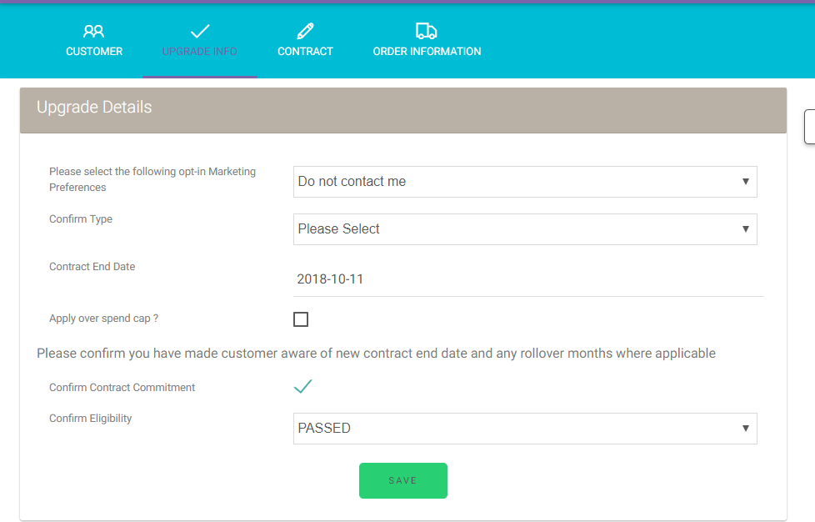
Quote Builder – Corporate upgrade info screen
Once you get to the credit check screen and you have filled in all of the required fields you need to set your spend cap in accordance with your DA/EEBA.
If the customer has opted out, please leave the ‘apply over spend cap’ box blank. This will auto generate that the customer has opted out on the proposal.
If you wish to add a spend cap, please tick the ‘apply over spend cap’ box and manually enter the amount required. You will also need to enter the emails addresses of 3 points of contact who wish to receive the alerts. This will pull through onto the order screen for you and the proposal. Please see the next slide for examples.

Slide 14
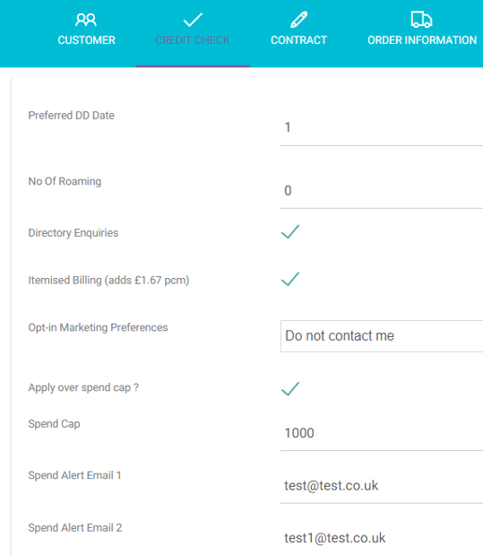
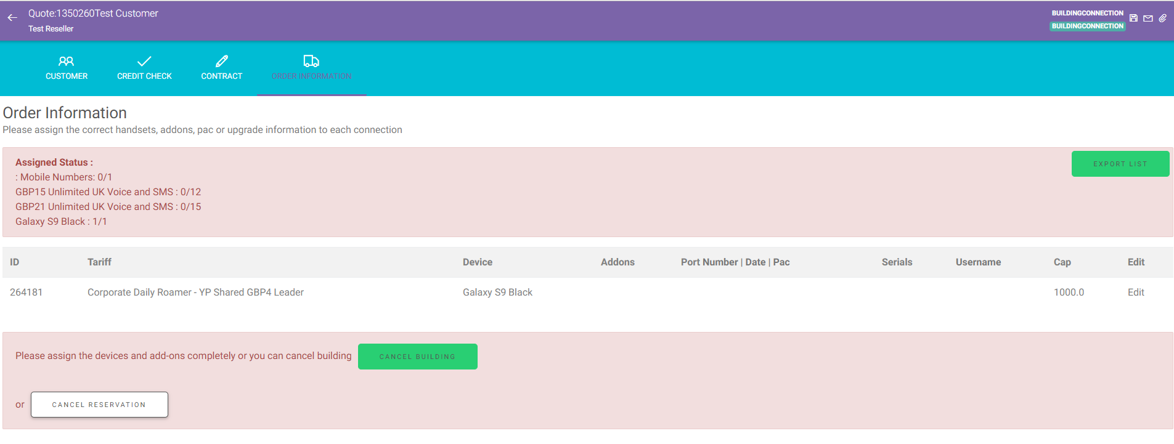
Quote Builder – Corporate order screen

