Slide 1

<Editable Date> | <Editable Team Member Name>
Call me on: <Editable Number> | Email me at: <Editable Email>
<Editable Date> | <Partner Name>
Call me on: <Editable Number> | Email me at: <Editable Email>
<add partner logo here>

Slide 2

Title | Information
Date
Customer Business Name
Customer Contact Name
Term of contract
Users
Data usage
Minutes & Texts usage
Hardware
Other information
Total cost per month
<add additional elements here>

Slide 3

Title | Information
<Title goes here> | <Information goes here>
<Title goes here> | <Information goes here>
<Title goes here> | <Information goes here>
<Title goes here> | <Information goes here>
<Title goes here> | <Information goes here>
<Title goes here> | <Information goes here>
<Title goes here> | <Information goes here>
<Title goes here> | <Information goes here>
<Title goes here> | <Information goes here>
Total cost per month

Slide 4
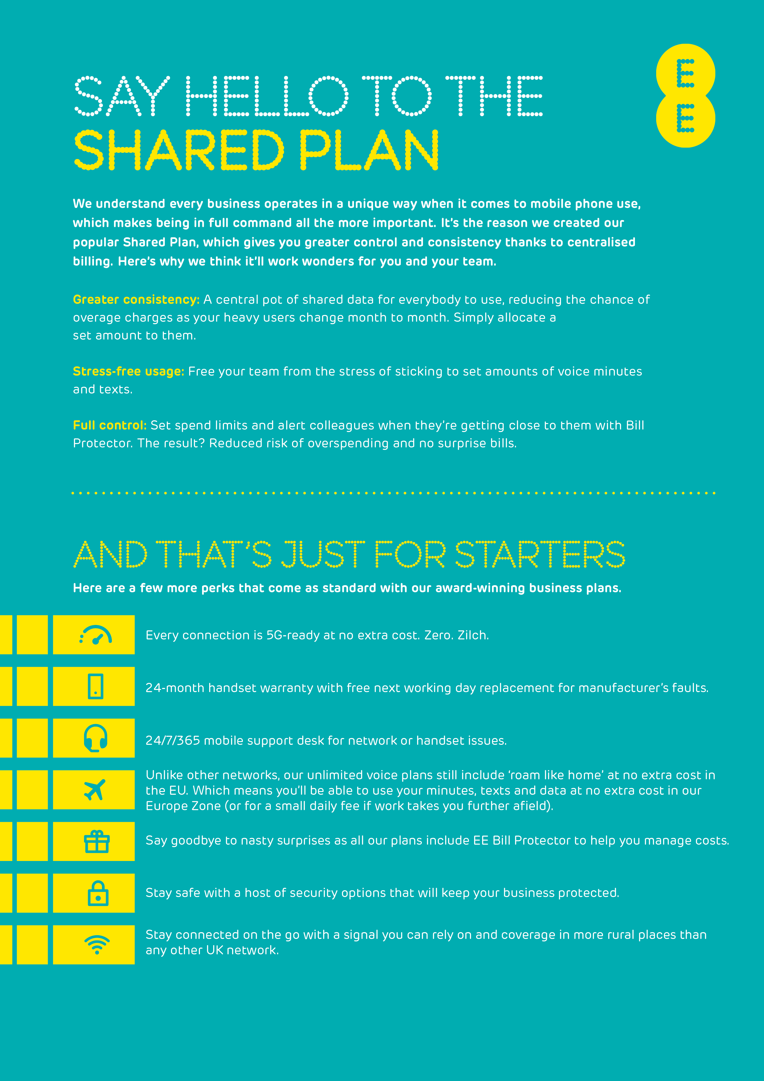

Slide 5


Slide 6


